Slide 1
General Services Department Contract Review Bureau Overview Training
Ray A. Maestas, Contract Review Bureau Chief
Anna Vigil, SPD Contract Analyst II
Jose Gomez, SPD Contract Analyst II
Antoinette Griego, SPD Contract Analyst II

Slide 2
Welcome
Introductions
What will we cover today?
Overview of Forms & Process
CRB’s Online Submission Portal
CRB Group email for any question: SPD.CRB@gsd.nm.gov

Slide 3
Scope of Work (SOW)
Finalized Scopes of Work should be clear & concise
Scopes of Work should be descriptive when inserting into your contract template or adding as an exhibit. Give your contractor clear expectations and instructions.
Ensure your SOW does not reiterate information that is already covered in your contract
Be careful with the use of bullet points
Also be careful with the use of acronyms. Spell out the term at the very beginning of your contract

Slide 4
Determination of Services
Send an email to spd.determination@gsd.nm.gov with the exact Scope of Work (SOW) that is in the contract for Determination of Services.
SOW in determination email must match SOW in contract.
SOW must be in the body of the email. COPY and PASTE from contract.
DO NOT send the SOW as an attachment.
SPD General Counsel will respond confirming either General Services or Professional Services.
General Service confirmations are not processed by CRB.
CRB only processes professional services contracts over 5k including GRT.
Determinations are required for all contracts
spd.determination@gsd.nm.gov

Slide 5
Horizons of New Mexico
On behalf of the New Mexico Council for Purchasing from Persons With Disabilities, Horizons of New Mexico, a central nonprofit agency, provides comprehensive statewide support to foster development of contracts for New Mexico's people with disabilities, community rehabilitation programs, and public bodies.
The New Mexico State Use Act, 13-1C-1 NMSA 1978, is an outgrowth of the state's continuing efforts to expand opportunities for its citizens with disabilities. The Act opens state service contracts, including contracts to provide service to the state as business owners and entrepreneurs, to persons with disabilities without their having to competitively bid for the contract - so long as the services are provided at fair market pricing.

Slide 6
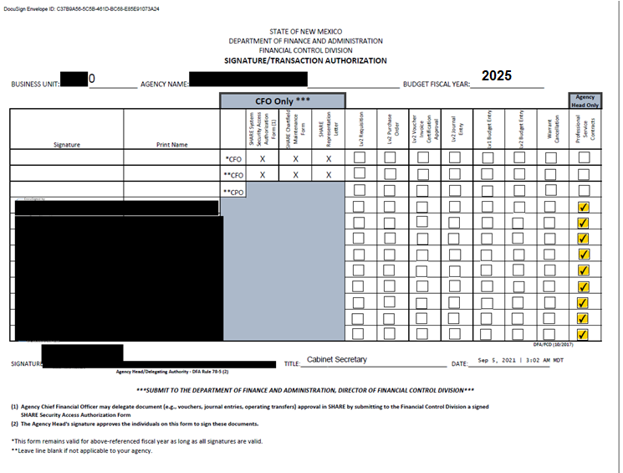
Signature Transaction Authorization Form
Send to CRB.
This is Important!
Make sure to include all pages if your form has multiple pages

Slide 7
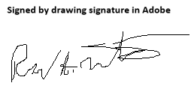
Acceptable Signatures
Digital signature
Scanned copy or image of actual signature
Signed by drawing signature in Adobe
DocuSign signature
Unacceptable Signatures
Do not use the type function in Adobe Signature.
Do not use the edit tool to add a text box to type your name or initials.

Slide 8
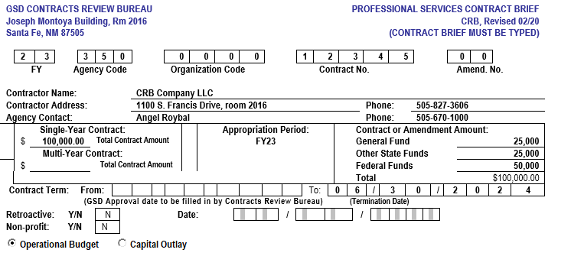
FILLING OUT THE BRIEF (new contract)
4. Contract number required. SHARE assigned or Agency assigned
3. Org code optional if no code enter all zeros
5. Amendment number e.g. 01. If new contract enter zeros
1. Fiscal Year that original contract is effective
2. Your agency Org code e.g. 350 (GSD)
6. Contractor information Must match SHARE
8a: Amount for services provided in one fiscal year
7. Agency contracts processor contact information
8b: Amount for services provided that cross multiple fiscal years
10. Budget amounts for new contract.
11. Leave blank for original contract and for amendments, enter date original contract was effective
13. Retroactive effective dates need approval from GSD secretary (should always be “N”)
14. Indicate whether or not vendor is a non-profit organization
9. Enter all fiscal year(s)
contract is valid
12. Date contract expires

Slide 9
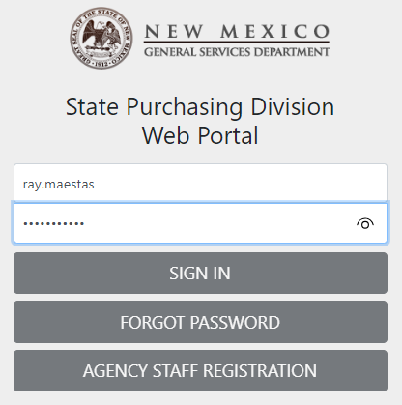

Slide 10
Written Brief
Portal Brief

Slide 11
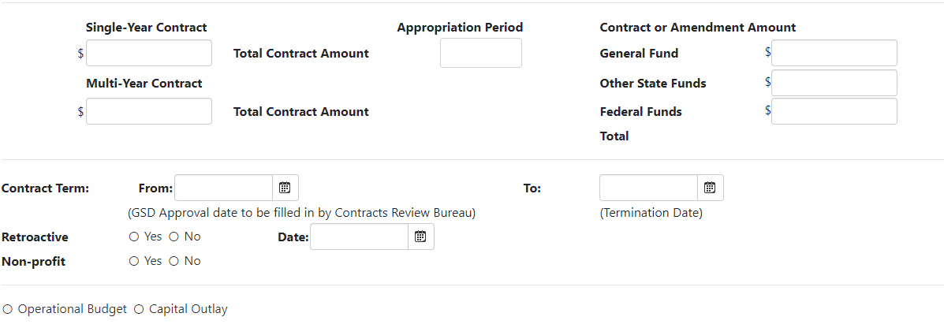

Slide 12
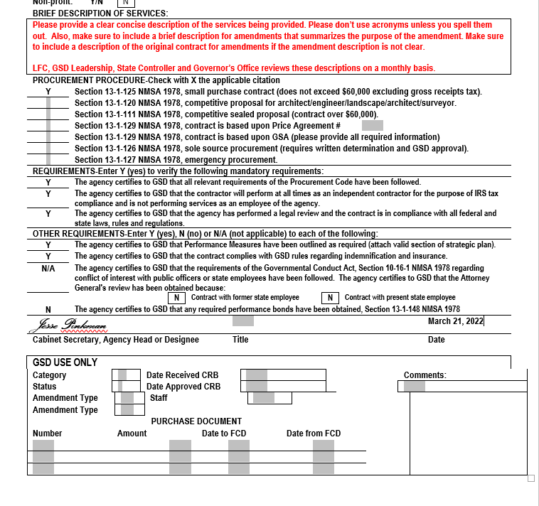
FILLING OUT THE BRIEF (cont’d)
15. Brief description of services. Should not be longer than available space.
16. “X” marks the spot. Only choose one type for the contract.
17. All answers should be “Y”
18. Type the answer that pertains to your contract
19. Name of agency head or representative authorized by DFA to sign for agency head

Slide 13
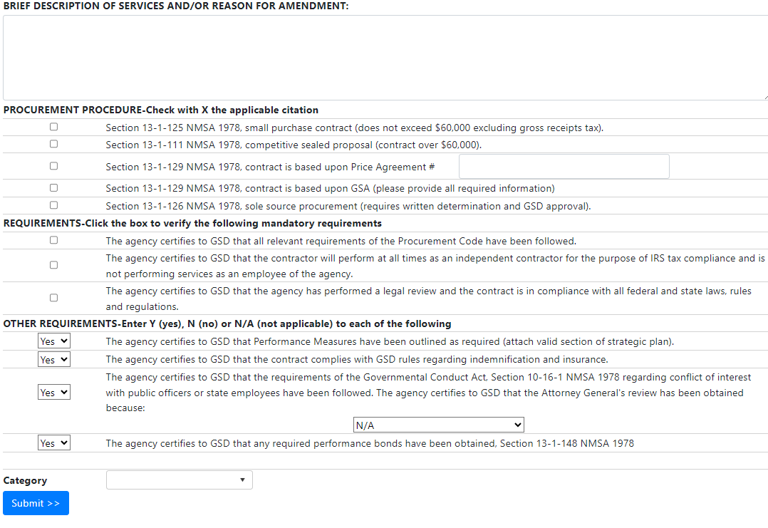

Slide 16
Contract Template
CRB Boilerplate/Templates can be found on the CRB website
IT Template($60k or less or over $60k) DoIT Templates
Contract Amendment Form 5-5-21
Contract Boilerplate Form 10-4-19 for original contracts
The Contract Boilerplate Form is not to be altered without deviation approval.
Deviations from the template may be requested in order to fit the agency’s practices
Do not forget to include Section C. of your compensation article

Slide 17
AMENDMENTS
Amendments are processed when the parties request changes to the terms and conditions stated in the original or prior amendments.
Increasing compensation?
Must add to scope of work – additional hours or services
or
Extend term of contract
Remove clauses that do not pertain to the amendment
Refer to Contract Checklist for required documents
Scope of work:
Ensure the amendment SOW does not cancel out the original SOW or a part of the SOW that is essential to the program.
Follow the same SOW guidelines as the original contract.
If your contract being amended was issued via RFP, make sure your new scope is still within the parameters of the RFP
Include the text “All other articles of this contract remain the same”

Slide 18
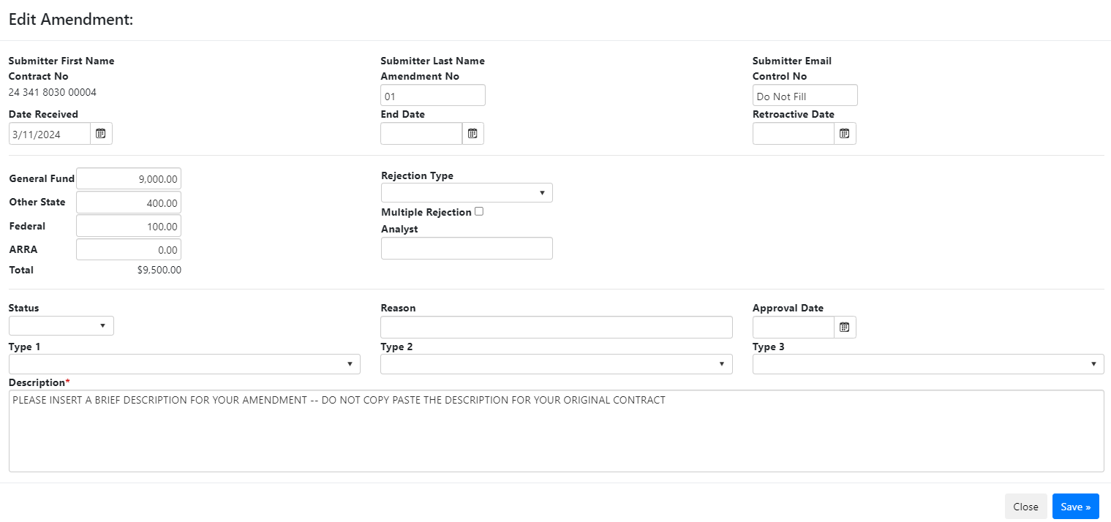

Slide 19
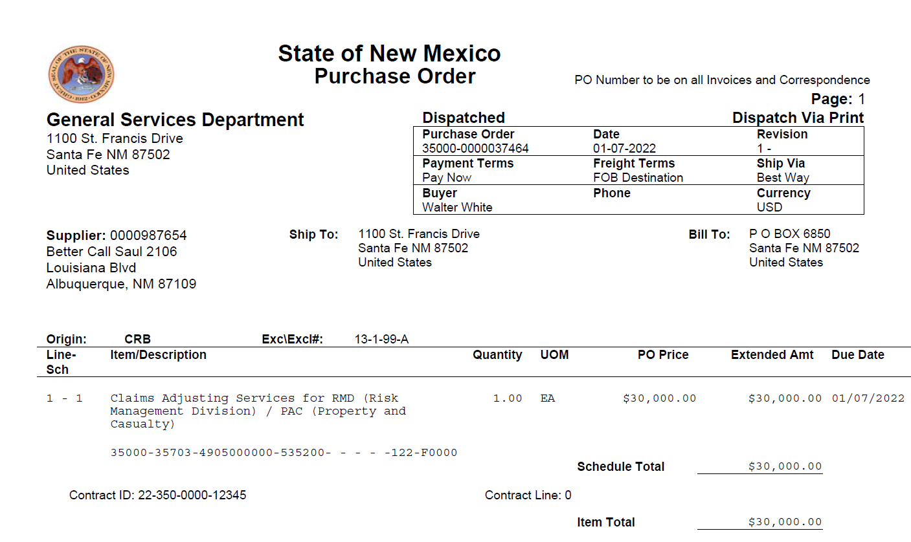
PSC PURCHASE ORDERS
Any purchase order submitted to CRB MUST be approved at the agency level
Must use CRB as the Origin for professional services contracts
Excluded from central purchasing through the state purchasing agent
Must always tie in SHARE contract module to purchase order
300’s Category Accounts:
535100 Medical Professional Services
535200 Professional Services
535400 Audit Services
535500 Attorney Services
535600 IT Services
535800 Capital
Always include full statewide price agreement number in the description of your purchase order if utilizing a statewide price agreement

Slide 20
SHARE Contract Module
This numbering sequence should match your numbering sequence on your Contract
Agency must approve module in order to tie in contract module to purchase order
Type must always be purchase order
Attach relevant documents edit comments
Corporate contract box must always be unchecked

Slide 21
SHARE Contract Module Continued
These two boxes must be checked for PSCs

Slide 22
AGENCY CERTIFICATION FORM
Form is required for all contracts: original and amendments.
These are good for 90 days. If your previous form is older than 90 days, you will need a new form. Otherwise, you can submit an existing form with amendments as long as it’s less than 90 days old.
Select whether or not the contractor is a former or current employee. Refer to the NOTE on the form as it contains pertinent information regarding the additional documentation that may be needed.
Only an authorized signatory may sign for the agency.

Slide 23
Other Required Forms and Memos
Affidavit of Former Employment
Found on GSD Website
New Mexico Public Employees Retirement (PERA) Memo (if former employee retired from NM State Government)
New Mexico Attorney General Memo - Former employee less than five years

Slide 24
RFP Documents
SPD has no authority over the professional services RFP process.
RFP Docs needed for CRB packet
Cover Page with RFP Name, Number and Date Issued
Scope of Work
Table of Contents
Sequence of Events
Proposal Offer Firm
Professional Service Contracts issued through the RFP process can have a term of up to 4 years.
ITBs are only used for general services contracts
Reach out to Susan Inman if your agency has a question on the RFP process. Info Below.
When submitting the RFP documents, please do not skip pages.
Example: If your last required section ends on page 20, please send pages 1-20 of the RFP with contract packet.
Susan Inman
Trainer
susan.inman@gsd.nm.gov
505-795-5551
Susan Offers the below training on a regular basis.
Procurement Code Overview
RFP Training
Link to Susan Inman Trainings:
https://www.generalservices.state.nm.us/state-purchasing/training/training-registration/

Slide 25
Price Agreements
Statewide Price Agreements can be used by all state agencies and local public bodies.
A professional service contract term date can supersede an expired price agreement as long as the professional service contract was in place before the price agreement expired.
Once a price agreement has expired, the professional service contract cannot be extended and/or compensation can’t be increased.
Price Agreement number needs to be in the PO description.
SPD collects fees from vendors based on the use of the price agreements and that's how it is currently tracked by SPD.
Price Agreement (What’s Needed?)
First page of the price agreement
Terms and conditions (If Applicable)
CRB may ask the agency for more information on the price agreement.

Slide 26
Sole Source Contracts
*A sole source procurement should be avoided whenever possible.
The first step of any procurement is to obtain an SPD Determination of services. This will determine how you process your contract. If it is deemed general services, it will not be processed by CRB. CRB only processes professional services contracts over 5k.
Determine the amount of the contract for a 12 month period. If it is less than $60k excluding GRT (in a 12 month period) you can process as a small purchase.
A Sole Source term is 12 months.
See GSD website for the most current sole source determination form.
Upload all required sole source documentation and submit on GSD Website.
CRB will obtain the State Purchasing Agent’s authorized signature when the contract is ready to be finalized.

Slide 27
Sole Source Continued
CRB is unable to process your sole source contract until AFTER the 30 day posting has occurred with NO PROTEST
If amending a sole source contract, the sole source process will need to be repeated.
If only GRT is being increased on a sole source, no 30 day posting is required.

Slide 28
Sole source process
CRB staff receives notification that sole source submission has been submitted through the SPD portal.
CRB staff reviews sole source submission confirming professional services determination included, checks vendor name, dates, amounts, etc.
If all looks ok, sole source determination submitted to SPD legal counsel.
If SPD legal counsel approves, CRB staff publishes sole source
Sole source posted for 30 days
Agency can continue with sole source processing but CRB can’t process or sign contract until 30 days has been completed with no protest.
Sole source determination form will be signed by State Purchasing Agent when contract is ready to be finalized by CRB. CRB Staff obtain State Purchasing Agent signature.
**It is very hard to correct a sole source submission in the SPD portal. Most submissions with errors will be canceled and will need to be resubmitted.

Slide 29
Overview Deviation Requests
One time deviations require memo from agency attorney or agency head stating the following:
Indicate which clause is deviating from the template
Why the agency is deviating from standard template
Ensure that the deviation will not adversely affect the interests of the state
Include red line copy of template where language is changed, added or subtracted
Blanket deviations must include the following:
Memo from agency’s Cabinet Secretary similar to one time deviation memo
Redline copy of template with requested deviations and justification for changes within the template.

Slide 30
Overview Deviation Requests Continued
CRB’s staff will review with SPD legal counsel. After review, legal counsel will then forward to GSD Cabinet Secretary for final approval.
GSD Cabinet Secretary will either approve or deny deviation request Deviations are only valid for one fiscal year
CRB may ask for the approval when submitting a contract packet so keep it handy!
CRB only manages deviation request that involve CRB’s contract template.
Agency will need to receive approval from DoIT if they are deviating from DoIT’s contract template.
The agency should be working with their General Counsel when deviating from the standard contract template language.

Slide 31
Agency Review IMPORTANT!
Before obtaining signatures please review the following:
Make sure the outline is following proper formatting
Acronyms need to be spelled out for first time use
Check for grammatical errors
Dates should fall within the contract term and allow time for approval from oversight agencies
Review for mathematical errors
Does vendor name on contract match's vendor name in SHARE?
Use the most current template found on GSD’s website
Utilize the checklist
Try not to cut and paste language from RFPs or resumes, etc…
Be sure to use all updated forms found on GSD’s website (Agency Certification, Brief, Affidavit, Sole Source Form, etc…)
Link to GSD/CRB website: https://www.generalservices.state.nm.us/state-purchasing/contracts-review-bureau/

Slide 32
Important Resources
DFA budget analyst link: https://www.nmdfa.state.nm.us/budget-division/
Financial Control Division (FCD) Audit Bureau: https://www.nmdfa.state.nm.us/financial-control/audit-bureau/
Model of Accounting Practices (MAPs) DFA Website: https://www.nmdfa.state.nm.us/financial-control/resource-information/manuals/
New Mexico Commission of Public Records: NMAC https://nmonesource.com/nmos/en/nav.do
Policy Exemption: https://www.nmdfa.state.nm.us/financial-control/resource-information/year-end-closing/
Horizons: https://horizonsofnewmexico.org/services.html
Contact for the DOJ’s office is Kristen Hovie: khovie@nmdoj.gov or Blaine Moffatt: Blaine.moffatt@nmdoj.gov
Contact for PERA’s Office: misty.schoeppner@pera.nm.gov
Governmental Conduct Act: https://www.nmag.gov/resources/publications/

Slide 33
Contract Processing Resources in DocuSign
Contract-related Templates Available
Contract Routing (Automated Signature Workflows)
Contract Brief
Agency Certification Form
Campaign Contribution Form
Support/Development Resources are Available on Request
Need Access to Send or Create Templates? Contact us at:
esignature@doit.nm.gov

Slide 34
Thank you for joining us! Please reach out to us whenever you have questions. We are here to help.

